Slide 1



KOLLA ANSIBLE WORKSHOP
Giovanni Marrucci, Cloud Infrastructure Engineer
DATE, 2025

Slide 2




































E4 TIMELINE
FIRST
ARM+GPU SERVER
FIRST
ARM CLUSTER
DATACENTER
CHIRON LAB
NVIDIA GRACE &
NVIDIA GRACE HOPPER
FIRST
HYBRID CPU-GPU
NVIDIA TESLA
CLUSTER
EUROHPC
JU CALLS
E4 DEUTSCHLAND
FOUNDATION
E4 ANALYTICS
FOUNDATION
2002
2009
2013
2018
2021
2023
2024
2005
2012
2016-2017
2019
2022
EPI SGA1
SGI ITALIA
ACQUISITION
D.A.V.I.D.E.
FIRST
OPENPOWER SERVER
& PETAFLOPS CLUSTER
PARTNER OF
SW INTEGRATION
& CI/CD FACTORY
EPI SGA2
BOLOGNA TECNOPOLO
(ECMWF | CINECA)
+
FIRST
RISC-V BASED CLUSTER
(Monte Cimone)
GenAI
ON PREMISE
GAIA
@ BOLOGNA TECNOPOLO
(CINECA)
FIRST
INFINIBAND
CLUSTER
299° IN TOP500 (JUNE 2017)
14° IN GREEN500 (JUNE 2017)
PEDRAFORCA
CLUSTER
EDOCC

Slide 3
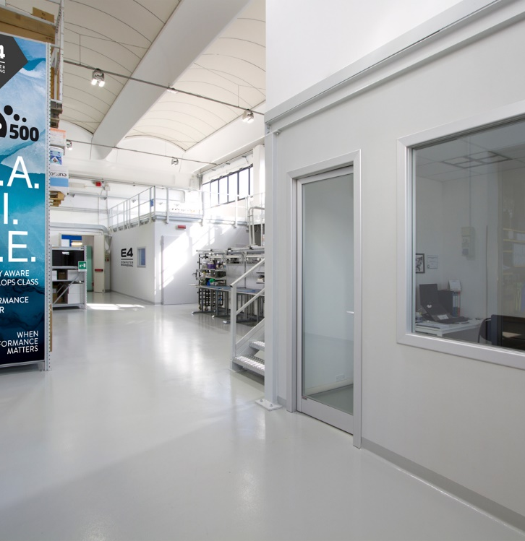
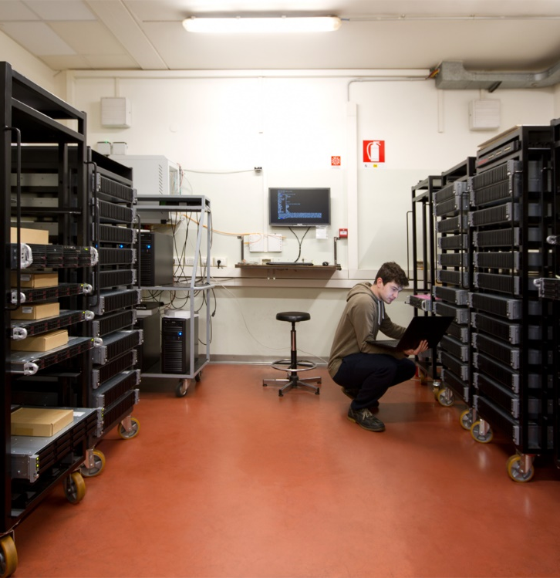
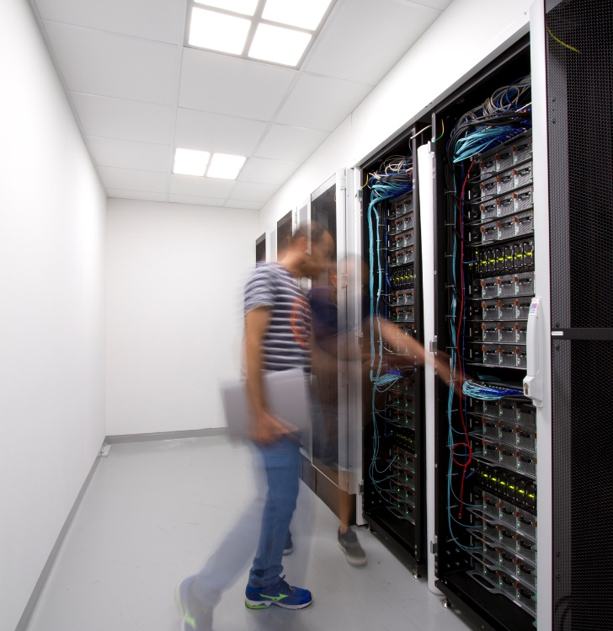
E4 TECH FACTORY
Scout, select, design, test, integrate, configure, optimize, validation & verification and install the full stack of HW & SW components and infrastructures
Expertise and advice services towards European target customers and prospects about the optimal solution for their needs
Consider the product development as a never-ending process, accept failures but strive for success
Apply co-design within a continuously changing scenario
Agnostic approach: supports the widest possible range of hw/sw components and operating systems
Notes:
Quando parlavo della vocazione intendevo l’attività che rende E4 una cosa rara tra I system integrator cioè la validazione in casa sia delle nuove soluzioni che di ogni singola macchina che viene venduta. Che sia un cluster o un singola ws su ogni macchina viene installato il sstema operative di test, che in questo momento è Rocky Linux, e per 72 h vengono eseguiti una serie di benchmark che vengono controllati con I dati di riferimento. Solo dopo questo step la macchina viene inviata o integrata in un nuovo cluster. Una gran parte dei problem in uscita dalla fabbrica vengono individuate qua.

Slide 4
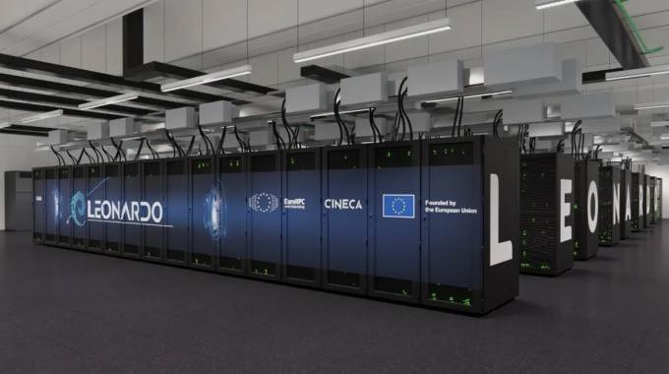
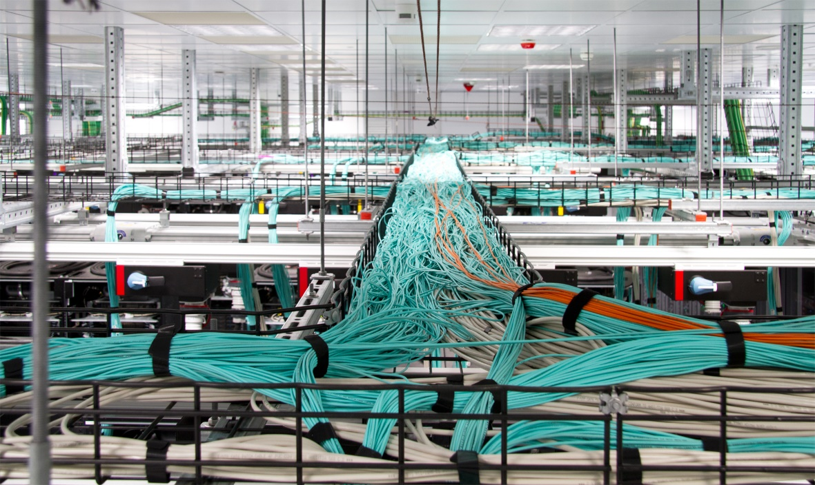

REFERENCE PROJECTS @ Bologna Technopole
2021
@ Bologna Technopole
Notes:
Non li abbiamo progettati e venduti noi ma dal loro deployment forniamo l’assistenza in sito per i due supercomputer del tecnopolo di Bologna ovvero leonardo (che oggi è scalato a numero 7 di Top500) ed il cluster dell’ECWMF da quando in grant bretagna hanno avuto la brillante idea della Brexit. In entrambi i casi parliamo di cluster con migliaia di nodi e qualche kilometro di dati che richiedono un costante controllo ed una pianificazione piuttosto complessa delle operazioni

Slide 5
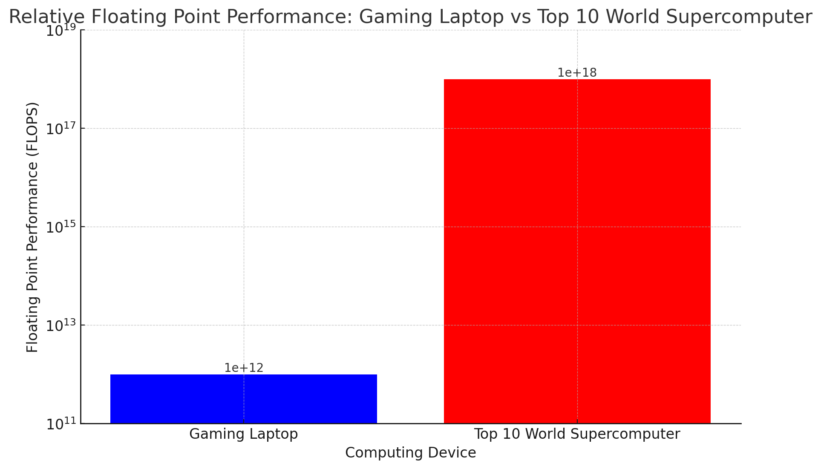
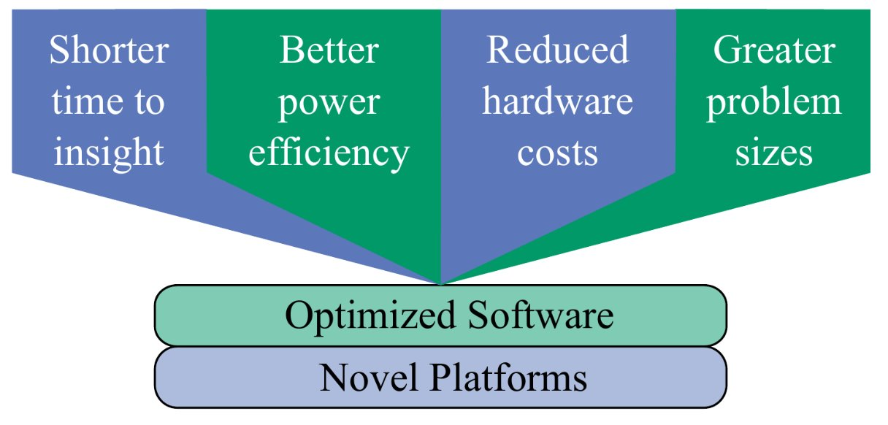




WHAT IS HPC – SPEED and SIZE
HPC Cluster
Workstation
HPC Cluster
Laptop
Problem size: problem does not fit single node (e. g. trillion param LLM)
Time to solution does not fit requirements (e. g. weather forecast, algo trading)

Slide 6

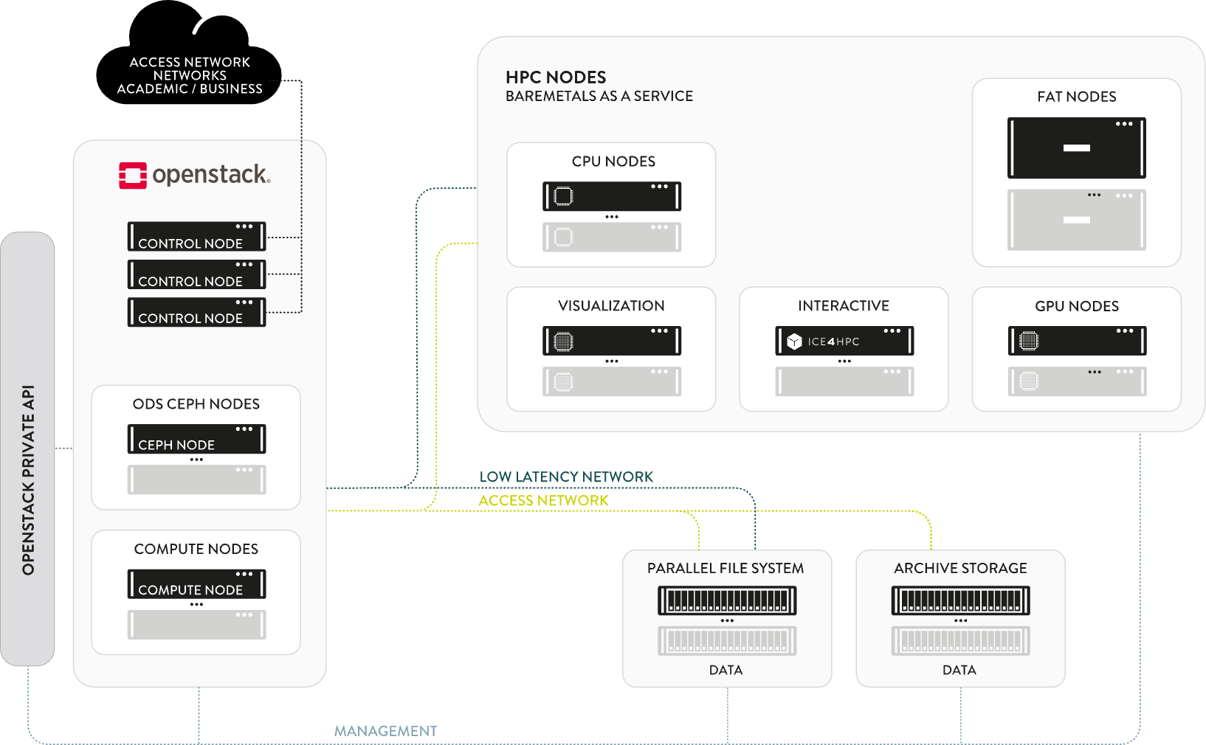
MEDOOZA ARCHITECTURE
Notes:
In conclusione c’è bisogno di (1) avere una infrastruttura che a parità di richieste e di utenti e in ultima analisi di calcoli effettuati sfrutti meno hardware molto più potente; che sia adattabile allo stesso momento a diversi usi sia di dominio che di complessità di esigenze e che vada incontro a regole diverse: voi potete non avere bisogno di proteggere i vostri dati (ma forse i vostri sorgenti sì) ma se per 6 mesi il vostro vicino di rack è un genetista lui sì. E come si può fare tutto ciò: facendo coesistere dinamicamente più cluster dentro lo stesso ferro, ovvero costruendo un cloud privato. In questo modo si ha il controllo delle proprie risorse, alla fine un risparmio rispetto al cloud pubblico (provare per credere), un partner per cui esisti cosa non da poco. Quindi questa è l’architetura di riferimento di E4 per l’HPC. …

Slide 7

Welcome to the workshop – OpenStack
Originally developed by Rackspace hosting and NASA
Managed by OpenInfra foundation
Contributions from single developers and big tech
OpenStack: open-source software platform for IaaS cloud computing
Main solution adopted for private cloud computing
It has the bid advantage of running on any type of hardware

Slide 8
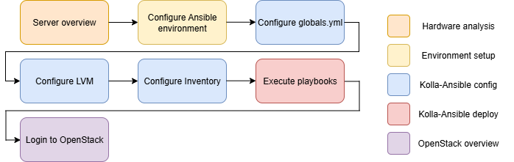
Welcome to the workshop – Order of operations

Slide 9

Welcome to the workshop – What will we do?
Each group of students will be provided with a virtual machine (VM) that will serve as the foundation for building a new OpenStack infrastructure. Why use a VM instead of a bare-metal server?A VM is more than sufficient for experimenting with OpenStack, as the platform can be installed on virtually any type of machine. In addition, bare-metal resources are significantly more expensive and unnecessary for our learning objectives.
Throughout the course, we will explore every aspect of an all-in-one OpenStack deployment, configuring and discussing the infrastructure and its main core services.

Slide 10
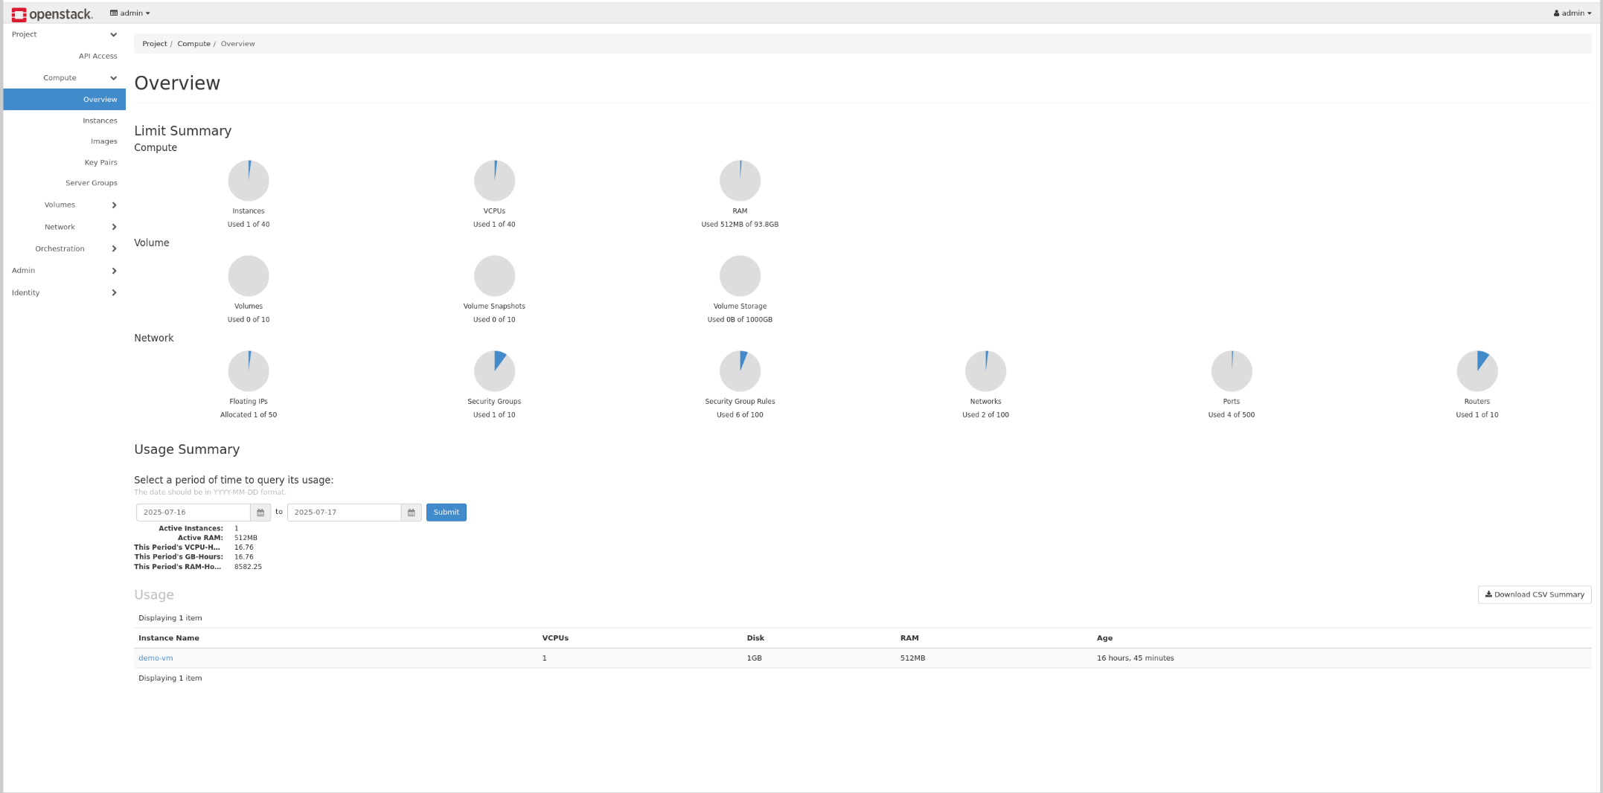
Welcome to the workshop – Our final objective

Slide 11
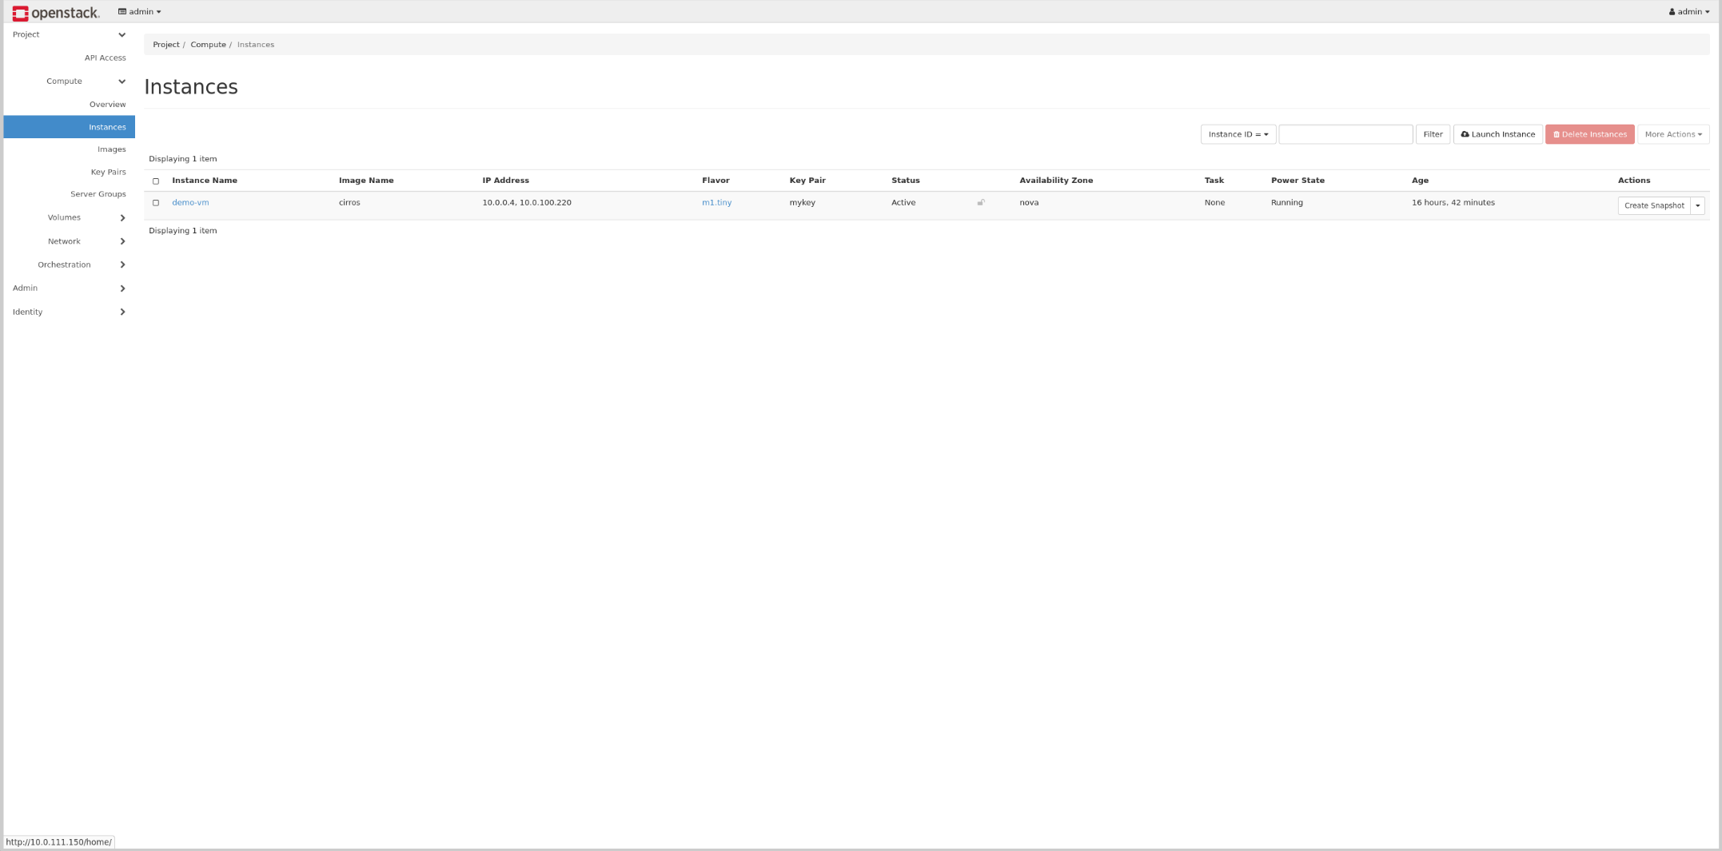
Welcome to the workshop – Our final objective

Slide 12
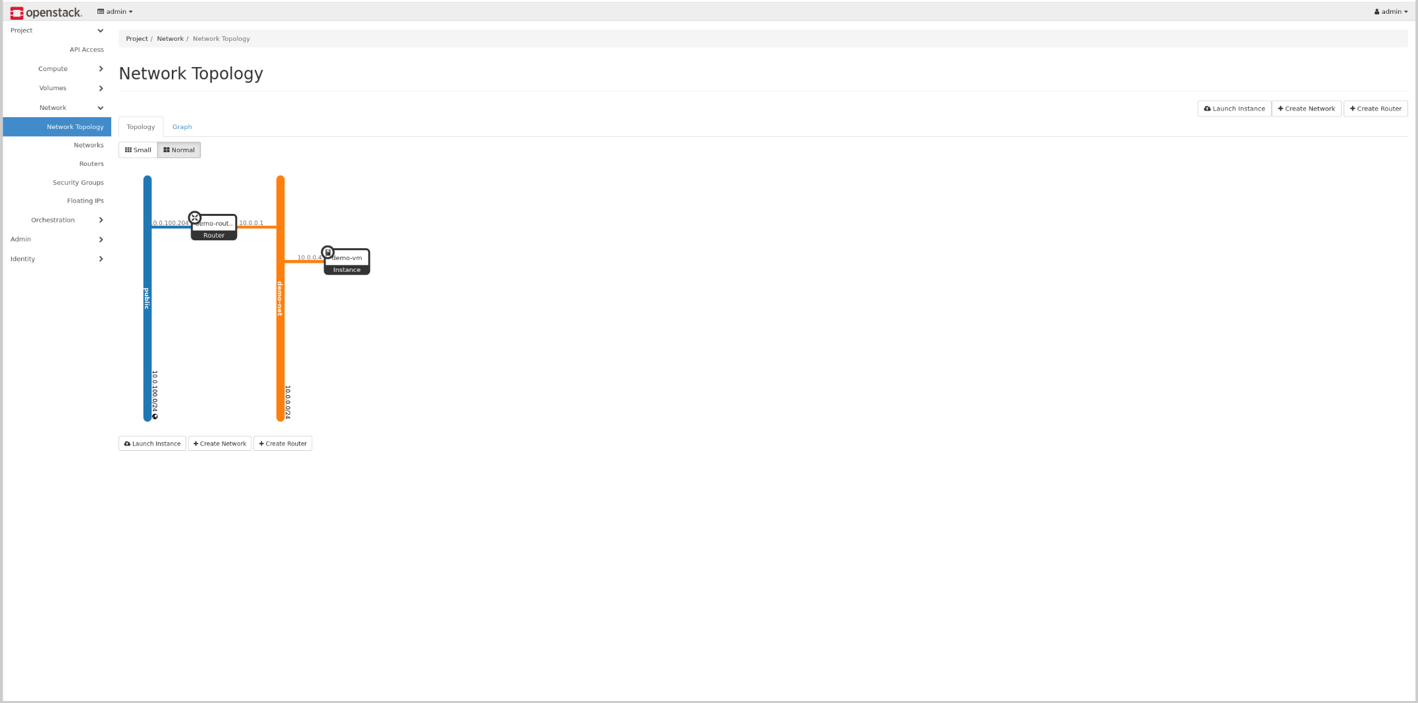
Welcome to the workshop – Our final objective

Slide 13









Welcome to the workshop – OpenStack
Each service provided by the cloud is a different project
Loosely-coupled: each service is deployed and configured separately
OpenStack services intercommunicate using REST APIs
Deployment and configuration - a project all of its own
Nova - compute
Cinder - volumes
Glance - images
Ironic - baremetal
Manila - fileshare
Keystone - identity
Neutron - network
Designate - DNS
Octavia - loadbalancers

Slide 14
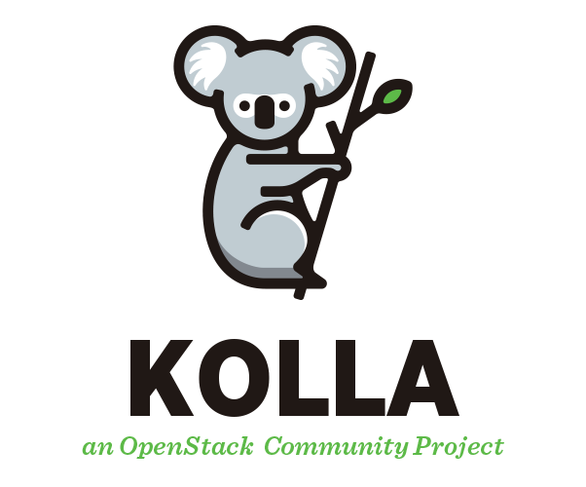
Welcome to the workshop – Kolla-Ansible
Kolla-Ansible is an OpenStack project that provides production-ready tools for deploying and managing OpenStack services in containers using Ansible.
It has the following advantages:
Containerized Services: All OpenStack services run in Docker containers.
Ansible-Based Deployment: It leverages Ansible for automation.
Scalable Architecture: Easy to provision multiple hosts
Safe updates: Supports non-disruptive, rolling upgrades
Community Driven: Maintained by a strong open-source community
Notes:
Modifica da Kolla a Kolla-Ansible

Slide 15

Welcome to the workshop – Ansible
Ansible is a suite of software
It enables infrastructure as code
It is open-source
Includes software provisioning, configuration management, and application deployment functionality
Based on Yaml and main engine python

Slide 16
Welcome to the workshop – Ansible
---
- name: Setup OpenStack Environment
hosts: openstack_nodes
become: true
vars:
e4user_password: "{{ ‘password' | password_hash('sha512') }}"
tasks:
- name: Update and upgrade all packages
ansible.builtin.apt:
update_cache: true
upgrade: dist
- name: Ensure e4user exists with sudo and password
ansible.builtin.user:
name: e4user
shell: /bin/bash
groups: sudo
append: true
password: "{{ e4user_password }}"
state: present
- name: Create OpenStack installation directory
ansible.builtin.file:
path: /openstack/e4user
state: directory
owner: e4user
group: e4user
mode: '0755'
recurse: true
[openstack_nodes]
10.30.0.101
10.30.0.102
10.30.0.103
10.30.0.104

Slide 17
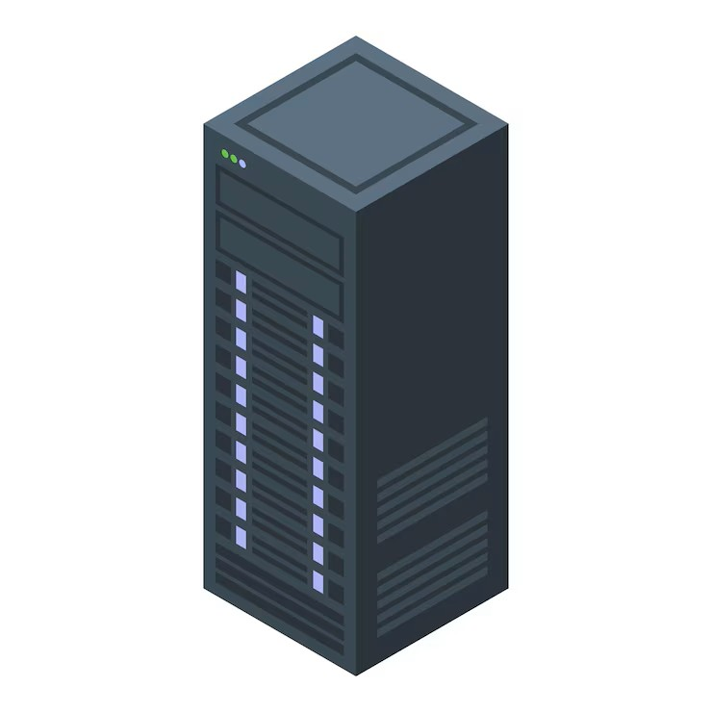
Your Machine – Hardware
Virtualization enabled in BIOS
Minimum 8 GB RAM (more recommended)
40+ GB disk for containers + storage for VMs
2 Physical devices
2 Network interfaces
Enough CPU cores for VM workloads

Slide 18

Your Machine – Software and Core Components
Ubuntu 24.04
All updates applied
Sudo user named `e4user`
OpenStack installation directory: `/openstack`
All mandatory packages for Kolla installed

Slide 19

Your Machine – Network Configuration
In Ubuntu, the network configuration is generally managed by netplan.
In our case we used systemd network manager because we had to define a complex system to interact with OpenStack networking.
e4user@testvm:~# ip -br –c a ens3 UP
ens4 UP 10.0.111.151/24
br0 UP 10.0.100.151/24
veth-ovs@veth-phy UP
veth-phy@veth-ovs UP

Slide 20
Your machine – Connecting to the Machine
To connect to the machine the following command must be used:
ssh e4user@<IP_reveiced_in_email>
(A password will be asked. The password was provided in the email)

Slide 21
Preparation – Ansible Environment
cd /openstack/e4user
python3 -m venv kolla_env
source kolla_env/bin/activate
pip install -U pip docker pkgconfig dbus-python
pip install git+https://opendev.org/openstack/kolla-ansible@stable/2025.1
Notes:
Fai un pdf/md per comandi

Slide 22
Preparation – Kolla Setup
sudo mkdir -p /etc/kolla
sudo chown $USER:$USER /etc/kolla
cp -r kolla_env/share/kolla-ansible/etc_examples/kolla/* /etc/kolla
cp kolla_env/share/kolla-ansible/ansible/inventory/all-in-one .

Slide 23
Configuring Kolla – Hands on
Questions?
Problems?
Suggestions?

Slide 24
Configuring Kolla – OpenStack Variables
Edit /etc/kolla/globals.yml:
kolla_base_distro: "ubuntu”
####### NOTE MODIFY HERE #########
kolla_internal_vip_address: "ens4_ip + 1 ” <<- This is retrieved using “ip –br –c a”
#################################
network_interface: "ens4"
neutron_external_interface: "veth-ovs"
enable_cinder: "true"
enable_cinder_backend_lvm: "true"
openstack_release: "2025.1"
docker_registry: "10.0.1.120:4000"
docker_registry_insecure: "yes"
docker_namespace: "openstack.kolla"
Note that the file is way longer, you will need only this
Notes:
Prima di questo metti screenshot del file, da pensare perché così in realtà il file è già tutto

Slide 25
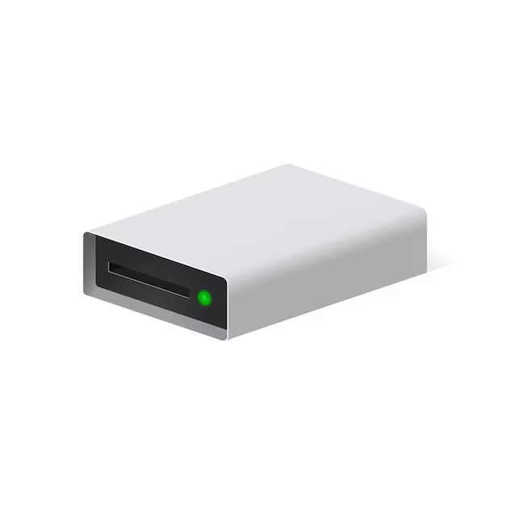
Configuring Kolla – Why LVM?
LVM is one of the supported backends for the Cinder storage service.
It is easy to configure and manage, since we only need to generate a volume group.
To configure it: sudo pvcreate /dev/vdb sudo vgcreate cinder-volumes /dev/vdb
To show the vg created: sudo vgs

Slide 26
Configuring Kolla – Inventory
The inventory is “the list” of hosts that will be targeted by the ansible playbooks.
In our case we only have the local machine so we can refer to is as localhost.
If you are curious to see all target groups for ansible watch the file: /openstack/e4user/all-in-one

Slide 27
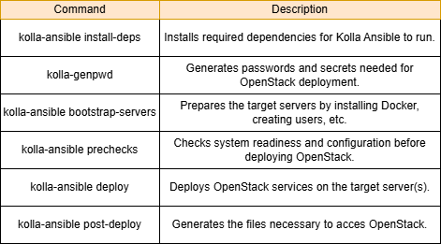
Executing Kolla – Playbooks
To deploy Openstack we will be using multiple commands
Each one executes a kolla-ansible’s playbooks
The commands must always be executed in order because each one has a specific usage case

Slide 28
Executing Kolla – Commands
Execute the following:
kolla-ansible install-deps
The command shown above will start to download all python packages and ansible collections needed to execute kolla-ansible. To verify if the installation was perfomed correctly it is enough to try auto-completion:
(kolla_env) e4user@test-vm:/openstack/e4user$ kolla-
kolla-ansible kolla-genpwd kolla-mergepwd kolla-readpwd kolla-writepwd

Slide 29
Executing Kolla – Commands
Execute the following:
kolla-genpwd
If this command is executed correctly then no output is shown. To check its effectiveness, print out what is written in : cat /etc/kolla/passwords.yml

Slide 30
Executing Kolla – Commands
Execute the following:
kolla-ansible bootstrap-servers -i ./all-in-one
To evaluate if the command correctly worked it is enough to reach the end of the playbook without any error and check if docker is installed now.

Slide 31
Executing Kolla – Commands
Execute the following:
kolla-ansible prechecks -i ./all-in-one
To evaluate if the command correctly worked it is enough to reach the end of the playbook without any error. A common error that might arise is linked to the misconfiguration of the interfaces listed in /etc/kolla/globals.yml. If that happens check them to be sure that are the correct ones.

Slide 32
Executing Kolla – Commands
Execute the following:
kolla-ansible deploy -i ./all-in-one
To evaluate if the command correctly worked it is enough to reach the end of the playbook without any error. If the /etc/kolla/globals.yml file is correctly written this should go smooth and in 15-20 minutes the installation process of openstack should be finished.

Slide 33
Executing Kolla – Commands
Execute the following:
Kolla-ansible post-deploy –i ./all-in-one
To evaluate if the command correctly worked it is enough to check if files for OpenStack authentication have been created:
(kolla_env) e4user@test-kolla:/openstack/e4user$ ls /etc/kolla/ | grep admin
admin-openrc-system.sh
admin-openrc.sh

Slide 34
Overcloud Administration – OpenStack services
To see the deployed services use: sudo docker ps -a
Services’ configurations and logs are in: sudo ls /etc/kolla sudo ls /var/log/kolla
To verify that the cinder volume lvm has been created: sudo lvs
Nova - compute
Cinder - volumes
Glance - images
Ironic - baremetal
Manila - fileshare
Keystone - identity
Neutron - network
Designate - DNS
Octavia - loadbalancers

Slide 35

Overcloud Administration – Logging into OpenStack
To access Openstack using the GUI, we can connect to Horizon using the IP specified as internal_vip_address.
A username and password will be requested.
Both the IP, username and password can be found in the admin-openrc.sh file.
This file is generally sourced and used to enable authentication for openstack CLI.
Authentication is provided through Keystone.
File path: /etc/kolla/admin-openrc.sh

Slide 36
Overcloud Administration – Generating Your Setup
Install the openstack cli: pip install python-openstackclient -c https://releases.openstack.org/constraints/upper/master
As previously mentioned, to administrate Openstack we need to source the credential files: source /etc/kolla/admin-openrc.sh
Then we can execute this bash script to generate automatically some basic resources: ./init-runonce.sh

Slide 37
Overcloud Administration – Connecting to the Instance
To connect to the instance, we need to use SSH
The VM’s OS is a cirrOS, therefore we will be using user ubuntu The keypair was automatically generated by the init-runonce.sh script and is stored in /openstack/e4user/keys/
The only thing that we do not know is the IP of the machine, to know it we just use: openstack server list
The command will display the info of the machine and it’s IP
To connect we do: ssh –i /openstack/e4user/keys/instanceKey cirros@IP

Slide 38

Conclusion
Congratulations!
Now you can successfully deploy and configure an Openstack all-in-one cluster using Kolla-Ansible!

Slide 39

Scaling Up - More Machines?
What if we wanted to create more machines and the only thing that we need is more storage space?
It is always possible to reconfigure OpenStack modifying its services.
In this case the service that we want to modify is Cinder
Cinder is the block storage service in OpenStack, and it allows users to create and manage volumes.

Slide 40

Scaling Up – NFS Backend
OpenStack Server
To expand the available space for OpenStack we will be using a NFS server.
Cinder supports multiple backends so the installation will have both LVM and NFS.
Cinder by default will uses the backend with more space to generate volumes
The behavior can be change modifying some variables in cinder’s configuration
10.30.0.0/24
NFS Server

Slide 41
Reconfiguring OpenStack – OpenStack variables
Add the following variables to globals.yml: enable_cinder_backend_nfs: "true"
Kolla retrieves services’ configurations from a specific directory: mkdir -p /etc/kolla/config
Execute this command to generate config file for kolla nfs: echo "10.0.1.120:/openstack/nfs" | tee "/etc/kolla/config/nfs_shares"

Slide 42
Reconfiguring OpenStack – Commands
Activate python environment: source /openstack/e4user/venv/bin/activate
Execute Kolla reconfiguration only for cinder backend: kolla-ansible reconfigure –t cinder -i ./all-in-one (NOTE: we use –t to target only the cinder service otherwise it would try to reconfigure all services)

Slide 43
Reconfiguring OpenStack – Cinder Backends Display
To see if the reconfigure worked we can list the volume services active in openstack:
(kolla_env) e4user@test-kolla:/openstack/e4user$ openstack volume service list
+------------------+------------------+------+---------+-------+----------------------------+---------+---------------+
| Binary | Host | Zone | Status | State | Updated At | Cluster | Backend State |
+------------------+------------------+------+---------+-------+----------------------------+---------+---------------+
| cinder-scheduler | test-kolla | nova | enabled | up | 2025-07-17T21:31:46.000000 | None | None |
| cinder-volume | test-kolla@lvm-1 | nova | enabled | up | 2025-07-17T21:31:30.000000 | None | None |
| cinder-backup | test-kolla | nova | enabled | up | 2025-07-17T21:31:21.000000 | None | None |
| cinder-volume | test-kolla@nfs-1 | nova | enabled | up | 2025-07-17T21:31:45.000000 | None | None |
+------------------+------------------+------+---------+-------+----------------------------+---------+---------------+

Slide 44
Additional resources - Useful Links
https://achchusnulchikam.medium.com/deploy-production-ready-openstack-using-kolla-ansible-9cd1d1f210f1
https://superuser.openinfra.org/articles/kolla-ansible-openstack-installation-ubuntu-24-04/
https://docs.openstack.org/kayobe/latest/getting-started.html
https://docs.openstack.org/kolla-ansible/latest/user/quickstart.html

Slide 45
Additional resources - You can try this at home
Ways to Try Out OpenStack:
Local Installation on Old Hardware Install Linux + OpenStack (DevStack/MicroStack/Packstack) on a spare laptop or desktop.
Using Libvirt on Your Machine Create VMs with KVM/Libvirt or VirtualBox, then deploy OpenStack inside them.
Free Cloud VMs (AWS/GCP/Azure) Practice installation on cloud VMs. Note that Guest VMs may not work due to disabled virtualization.

Slide 46

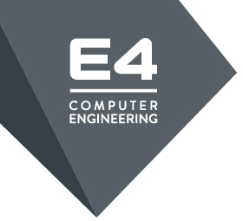
CONTACTS
CONTACTS
Email contacts
info@e4company.com
support@e4company.com
sales@e4company.com
E4 Computer Engineering SpA
Via Martiri della Libertà, 66 . 42019 Scandiano (RE) - Italy
Tel. +39 0522 991811

